Slide 1
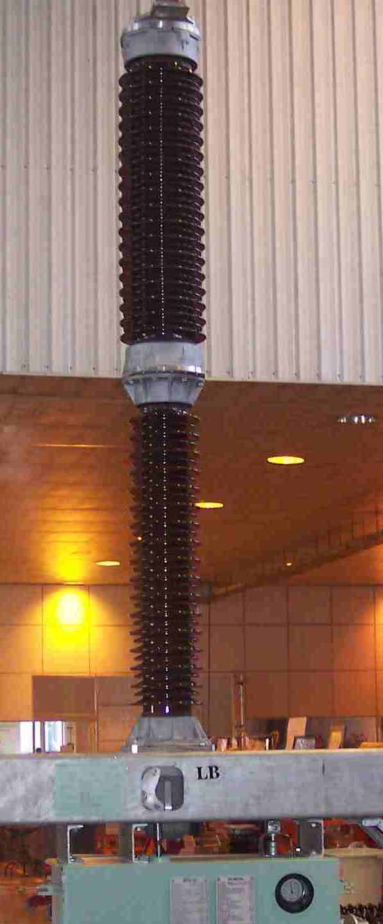
SIEMENS
HVCB SPARES
Chamber Insulator
72.5KV, 40KA & 145KV CB
S4901881759
Support Insulator
145KV, 40KA CB
S4901880755

